Slide 1
Greedy algorithms
David Kauchak CS 140 – Spring 2024

Slide 2
Admin
Assignment 6
ChatGPT
Collaboration

Slide 3
A problem
Input: a number k
Output: {n_{p}, n_{n}, n_{d}, n_{q}}, where n_{p}+5n_{n}+10n_{d}+25n_{q}=k and n_{p}+n_{n}+n_{d}+n_{q} is minimized
What is this problem?
How would you state it in English?

Slide 4
Making change!
Input: a number k
Output: {n_{p}, n_{n}, n_{d}, n_{q}}, where n_{p}+5n_{n}+10n_{d}+25n_{q}=k and n_{p}+n_{n}+n_{d}+n_{q} is minimized
Provide (U.S.) coins that sum up to k such that we minimize the number of coins

Slide 5
Making change!
Input: a number k
Output: {n_{p}, n_{n}, n_{d}, n_{q}}, where n_{p}+5n_{n}+10n_{d}+25n_{q}=k and n_{p}+n_{n}+n_{d}+n_{q} is minimized
Algorithm to solve it?

Slide 6
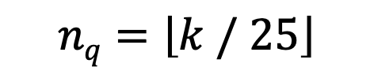
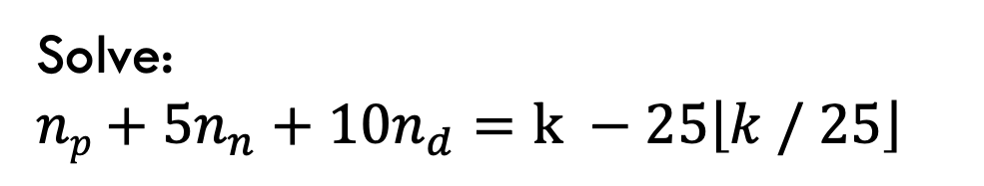
Making change!
Input: a number k
Output: {n_{p}, n_{n}, n_{d}, n_{q}}, where n_{p}+5n_{n}+10n_{d}+25n_{q}=k and n_{p}+n_{n}+n_{d}+n_{q} is minimized
$$nq=\left\lfloor k / 25\right\rfloor$$
pick as many quarters as we can
Solve:
$np+5n_{n}+10n_{d}=$ $k −25\left\lfloor k / 25\right\rfloor$
recurse

Slide 7
Algorithms vs heuristics
What is the difference between an algorithm and a heuristic?
Algorithm: a set of steps for arriving at the correct solution
Heuristic: a set of steps that will arrive at some solution

Slide 8
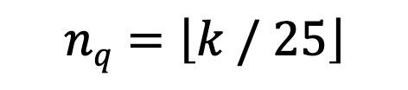
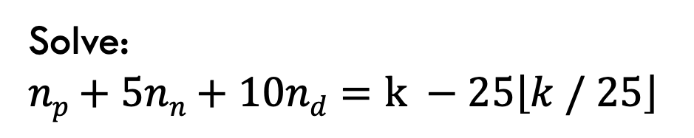
Making change!
$$nq=\left\lfloor k / 25\right\rfloor$$
pick as many quarters as we can
Solve:
$np+5nn+10nd=$ $k −25\left\lfloor k / 25\right\rfloor$
recurse
Algorithm or heuristic?
Need to prove its correct!

Slide 9
Greedy algorithms
What is a greedy algorithm?
Algorithm that makes a local decision with the goal of creating a globally optimal solution.
Method for solving problems where optimal solutions can be defined in terms of optimal solutions to sub-problems.
What does this mean? Where have we seen this before?

Slide 10
Divide and conquer
Divide and conquer
To solve the general problem:
Break into sum number of sub problems, solve:
then possibly do a little work

Slide 11
Divide and conquer
Divide and conquer
To solve the general problem:
The solution to the general problem is solved with respect to solutions to sub-problems!

Slide 12
Greedy vs. divide and conquer
Greedy
To solve the general problem:
Pick a locally optimal solution and repeat

Slide 13
Greedy vs. divide and conquer
Greedy
To solve the general problem:
The solution to the general problem is solved with respect to solutions to sub-problems!
Slightly different than divide and conquer.

Slide 14
Greedy vs. DP
greedy
Only recurse on one subproblem
dynamic
programming
…
Need to solve (recurse on) subproblems to figure out optimal answer

Slide 15
Proving correctness: greedy choice property
Greedy choice property: The greedy choice is contained within some optimal solution
The greedy choice results in an optimal solution

Slide 16
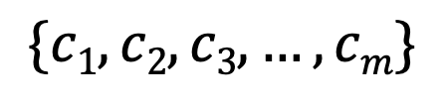
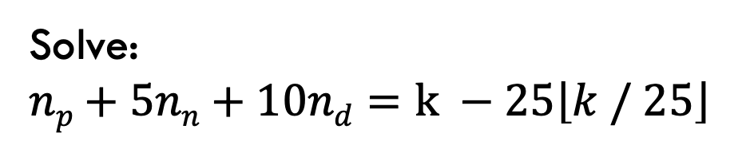
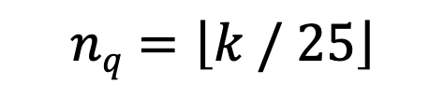
Making change!
$$nq=\left\lfloor k / 25\right\rfloor$$
pick as many quarters as we can
Solve:
$np+5nn+10nd=$ $k −25\left\lfloor k / 25\right\rfloor$
recurse
$$\{c1, c2, c3, …, cm\}$$
solution: individual coins selected

Slide 17
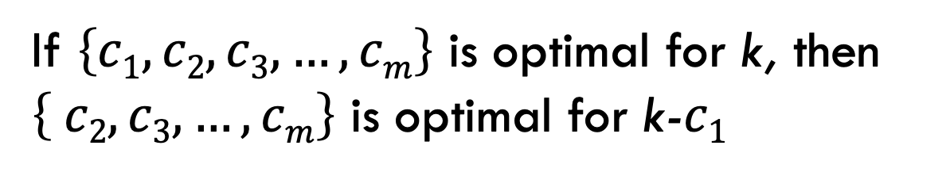
Optimal substructure
If $\left\{c1, c2, c3, …, cm\right\}$ is optimal for k, then $\left\{ c2, c3, …, cm\right\}$ is optimal for k-$c1$
We can combine a greedy choice with the optimal solution for the remaining problem and get a solution to the general problem

Slide 18
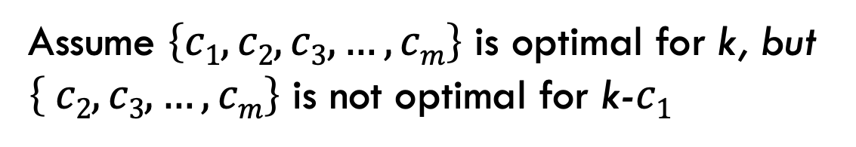
Optimal substructure
Proof by contradiction:
Assume $\left\{c1, c2, c3, …, cm\right\}$ is optimal for k, but $\left\{ c2, c3, …, cm\right\}$ is not optimal for k-$c1$
What does that imply?

Slide 19
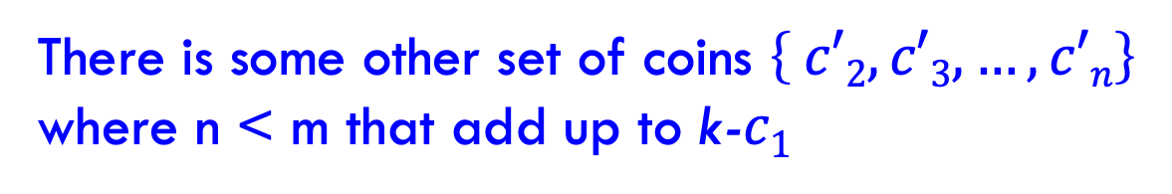
Optimal substructure
Proof by contradiction:
Assume $\left\{c1, c2, c3, …, cm\right\}$ is optimal for k, but $\left\{ c2, c3, …, cm\right\}$ is not optimal for k-$c1$
There is some other set of coins $\left\{ c′2, c′3, …, c′n\right\}$ where n < m that add up to k-$c1$
Any problem contradiction?

Slide 20
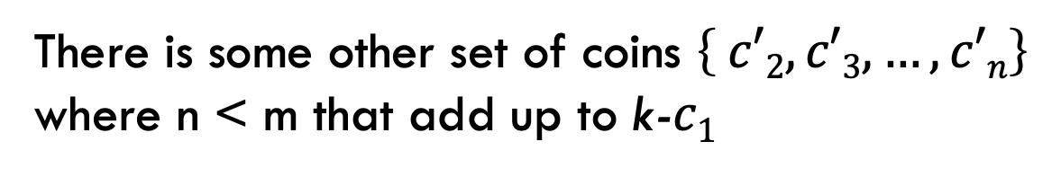
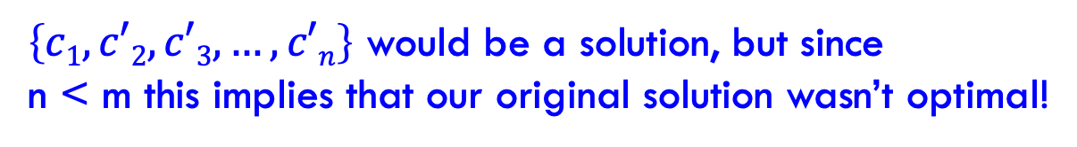
Optimal substructure
Proof by contradiction:
Assume $\left\{c1, c2, c3, …, cm\right\}$ is optimal for k, but $\left\{ c2, c3, …, cm\right\}$ is not optimal for k-$c1$
There is some other set of coins $\left\{ c′2, c′3, …, c′n\right\}$ where n < m that add up to k-$c1$
$\left\{c1, c′2, c′3, …, c′n\right\}$ would be a solution, but since n < m this implies that our original solution wasn’t optimal!

Slide 21
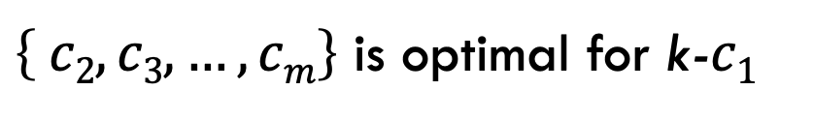
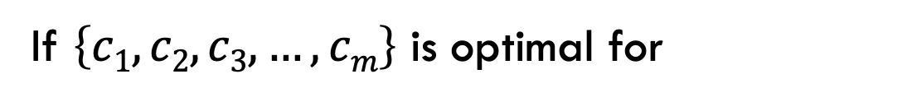
Optimal substructure
If $\left\{c1, c2, c3, …, cm\right\}$ is optimal for
$\left\{ c2, c3, …, cm\right\}$ is optimal for k-$c1$
We can make greedy decisions

Slide 22
Proving greedy choice property
Option 1: proof by contradiction
Assume you have an optimal solution to the problem
Sometimes you must think about it in an ordered/arranged a particular way.
Assume that somewhere along the way the solution contains a decision that is different than your greedy algorithm.
Argue this results in a contradiction, i.e., that the solution you’re considering is not optimal.

Slide 23
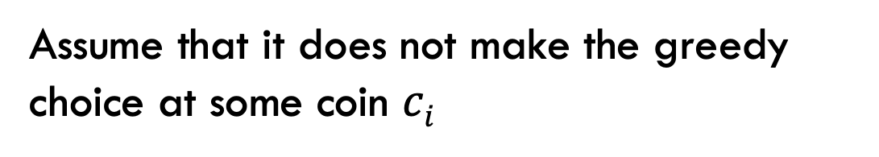
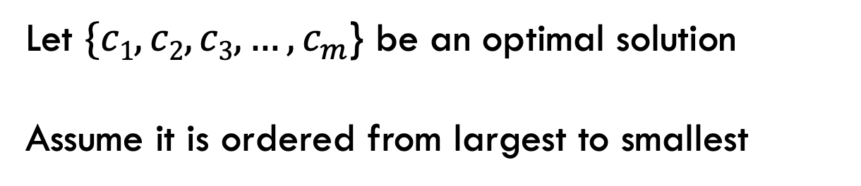
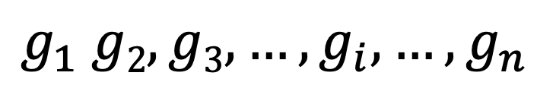
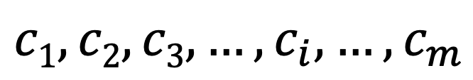
Greedy choice property
Proof by contradiction:
Let $\{c1, c2, c3, …,c_{m}$} be an optimal solution
Assume it is ordered from largest to smallest
Assume that it does not make the greedy choice at some coin $ci$
$$c1, c2, c3, …,c_{i},…, c_{m}$$
$$g_{1} g2, g3, …,g_{i},…, g_{n}$$
Any problem contradiction?

Slide 24
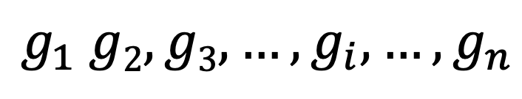
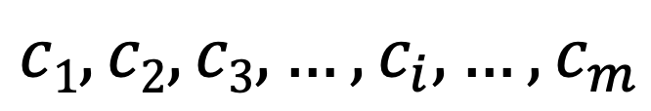
Greedy choice property
Proof by contradiction:
$$c1, c2, c3, …,c_{i},…, c_{m}$$
$$g_{1} g2, g3, …,g_{i},…, g_{n}$$
g_{i} > c_{i}. We need at least one more lower denomination coin because g_{i} can be made up of c_{i} and one or more of the other denominations.
but that would mean that the solution is longer than the greedy solution!

Slide 25
Greedy choice property
g_{i} > c_{i}
g_{i} = 5
c_{i} = 1
there are at least 4 other pennies
could always replace 5 pennies with a nickel to create shorter solution!

Slide 26
Greedy choice property
g_{i} > c_{i}
g_{i} = 10
c_{i} = 5
there are at least 2 nickels (assuming we’ve dealt with pennies first)
could always replace those coins with a dime to create a shorter solution

Slide 27
Greedy choice property
g_{i} > c_{i}
g_{i} = 25
r = remaining sum
coins(r – 25): number of coins to get remaining sum - 25
c_{i} = 10: 10 + 10 + 5 + coins(r-25)
c_{i} = 5: 5 + 5 + 5 + 5 +5 + coins(r-25)
The greedy solution will always be better

Slide 28
Greedy choice property fails
Coins: 9, 4, 1
What’s the best way to make 12?

Slide 29
Greedy choice property fails
Coins: 9, 4, 1
g_{i} > c_{i}
g_{i} = 9
r = remaining sum
coins(r – 9): number of coins to get remaining sum - 9
c_{i} = 4: 4 + coins(r-4)
There is no way to guarantee that we would have to use the same set of coins are coins(r-9)

Slide 30
Interval scheduling
Given n activities A = [a₁,a₂, ..,a_{n}] where each activity has start time s_{i} and a finish time f_{i}. Schedule as many as possible of these activities such that they don’t conflict.

Slide 31
Interval scheduling
Given n activities A = [a₁,a₂, .., a_{n}] where each activity has start time s_{i} and a finish time f_{i}. Schedule as many as possible of these activities such that they don’t conflict.
Which activities conflict?

Slide 32
Interval scheduling
Given n activities A = [a₁,a₂, .., a_{n}] where each activity has start time s_{i} and a finish time f_{i}. Schedule as many as possible of these activities such that they don’t conflict.
Which activities conflict?

Slide 33
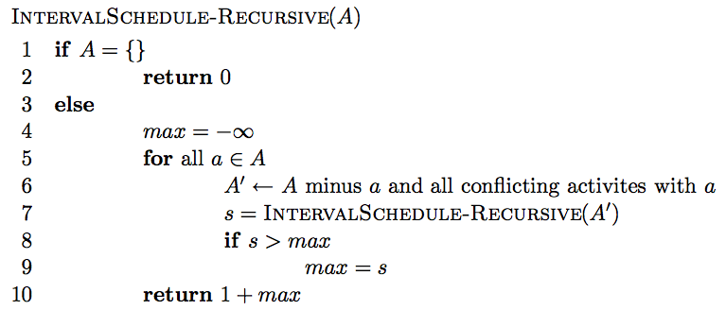
Simple recursive solution
Enumerate all possible solutions and find which schedules the most activities.

Slide 34
Simple recursive solution
Is it correct?
max{all possible solutions}
Running time?
O(n!)

Slide 35
Can we do better?
Dynamic programming
O(n²)
Greedy solution – Is there a way to repeatedly make local decisions?
Key: we’d still like to end up with the optimal solution

Slide 36
Overview of a greedy approach
Greedily pick an activity to schedule
Add that activity to the answer
Remove that activity and all conflicting activities. Call this A’.
Repeat on A’until A’ is empty

Slide 37
Greedy options

Slide 38
Greedy options
Select the activity that starts the earliest, i.e., argmin{s₁, s₂, s₃, …, s_{n}}?

Slide 39
Greedy options
Select the activity that starts the earliest, i.e. argmin{s₁, s₂, s₃, …, s_{n}}?
non-optimal

Slide 40
Greedy options
Select the shortest activity, i.e. argmin{f₁-s₁, f₂-s₂, f₃-s₃, …, f_{n}-s_{n}}

Slide 41
Greedy options
Select the shortest activity, i.e. argmin{f₁-s₁, f₂-s₂, f₃-s₃, …, f_{n}-s_{n}}
non-optimal

Slide 42
Greedy options
Select the activity with the smallest number of conflicts

Slide 43
Greedy options
Select the activity with the smallest number of conflicts

Slide 44
Greedy options
Select the activity with the smallest number of conflicts

Slide 45
Greedy options
Select the activity that ends the earliest, i.e., argmin{f₁, f₂, f₃, …, f_{n}}?

Slide 46
Greedy options
Select the activity that ends the earliest, i.e. argmin{f₁, f₂, f₃, …, f_{n}}?
remove the conflicts

Slide 47
Greedy options
Select the activity that ends the earliest, i.e. argmin{f₁, f₂, f₃, …, f_{n}}?

Slide 48
Greedy options
Select the activity that ends the earliest, i.e. argmin{f₁, f₂, f₃, …, f_{n}}?

Slide 49
Greedy options
Select the activity that ends the earliest, i.e. argmin{f₁, f₂, f₃, …, f_{n}}?
remove the conflicts

Slide 50
Greedy options
Select the activity that ends the earliest, i.e. argmin{f₁, f₂, f₃, …, f_{n}}?

Slide 51
Greedy options
Select the activity that ends the earliest, i.e. argmin{f₁, f₂, f₃, …, f_{n}}?

Slide 52
Greedy options
Select the activity that ends the earliest, i.e. argmin{f₁, f₂, f₃, …, f_{n}}?

Slide 53
Greedy options
Select the activity that ends the earliest, i.e. argmin{f₁, f₂, f₃, …, f_{n}}?

Slide 54
Greedy options
Select the activity that ends the earliest, i.e. argmin{f₁, f₂, f₃, …, f_{n}}?
Multiple optimal solutions

Slide 55
Greedy options
Select the activity that ends the earliest, i.e. argmin{f₁, f₂, f₃, …, f_{n}}?

Slide 56
Greedy options
Select the activity that ends the earliest, i.e. argmin{f₁, f₂, f₃, …, f_{n}}?

Slide 57
Efficient greedy algorithm
Once you’ve identified a reasonable greedy heuristic:
Prove that it always gives the correct answer.
Develop an efficient solution.

Slide 58
Is our greedy approach, correct?
Option 1: proof by contradiction
Option 2:“Stays ahead” argument:
show that no matter what other solution someone provides you, the solution provided by your algorithm always “stays ahead”, in that no other choice could do better.

Slide 59
Is our greedy approach, correct?
“Stays ahead” argument
Let r₁, r₂, r₃, …, r_{k} be the solution found by our approach
Let o₁, o₂, o₃, …, o_{k} be another optimal solution
Show our approach “stays ahead” of any other solution.
…
r₁
r₂
r₃
r_{k}
…
o₁
o₂
o₃
o_{k}

Slide 60
Stays ahead
…
r₁
r₂
r₃
r_{k}
…
o₁
o₂
o₃
o_{k}
Compare first activities of each solution
what do we know?

Slide 61
Stays ahead
…
r₁
r₂
r₃
r_{k}
…
o₁
o₂
o₃
o_{k}
finish(r₁) ≤ finish(o₁)
what does this imply?

Slide 62
Stays ahead
…
r₂
r₃
r_{k}
…
o₂
o₃
o_{k}
We have at least as much time as any other solution to schedule the remaining 2…k tasks.

Slide 63
Stays ahead
…
r₂
r₃
r_{k}
…
o₂
o₃
o_{k}
We have at least as much time as any other solution to schedule the remaining 2…k tasks
What kind of proof is this?
Notes:
proof by induction!

Slide 64
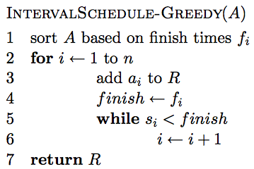
An efficient solution

Slide 65
Running time?
Θ(n log n)
Θ(n)
Better than:
O(n!) O(n²)
Overall: Θ(n log n)

Slide 66
Scheduling all intervals
Given n activities, we need to schedule all activities. Goal: minimize the number of resources required.

Slide 67
Greedy approach?
The best we could ever do is the maximum number of conflicts for any period.

Slide 68
Calculating max conflicts efficiently

Slide 69
Calculating max conflicts efficiently
3

Slide 70
Calculating max conflicts efficiently
1

Slide 71
Calculating max conflicts efficiently
3

Slide 72
Calculating max conflicts efficiently
1

Slide 73
Calculating max conflicts efficiently
…

Slide 74
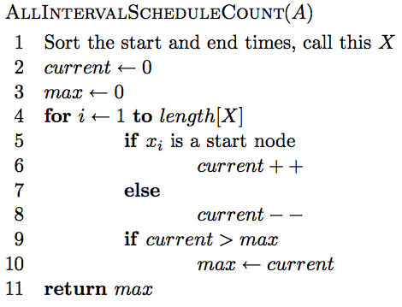
Calculating max conflicts

Slide 75
Correctness?
We can do no better than the max number of conflicts. This exactly counts the max number of conflicts.

Slide 76
Runtime?
O(2n log 2n + n) = O(n log n)

Slide 77
Knapsack problems: Greedy or not?
0-1 Knapsack – A thief robbing a store finds n items worth v₁, v₂, .., v_{n} dollars and weight w₁, w₂, …, w_{n} pounds, where v_{i} and w_{i} are integers. The thief can carry at most W pounds in the knapsack. Which items should the thief take if he wants to maximize value.
Fractional knapsack problem – Same as above, but the thief happens to be at the bulk section of the store and can carry fractional portions of the items. For example, the thief could take 20% of item i for a weight of 0.2w_{i} and a value of 0.2v_{i}.

Slide 78
Handout

Slide 79
Here are some options for greedy algorithms. Do they work? Can you come up with counterexamples?
Starts earliest
Least number of conflicts
Shortest

Slide 80
Knapsack problems: Greedy or not?
0-1 Knapsack – A thief robbing a store finds n items worth v₁, v₂, .., v_{n} dollars and weight w₁, w₂, …, w_{n} pounds, where v_{i} and w_{i} are integers. The thief can carry at most W pounds in the knapsack. Which items should the thief take if he wants to maximize value.
Fractional knapsack problem – Same as above, but the thief happens to be at the bulk section of the store and can carry fractional portions of the items. For example, the thief could take 20% of item i for a weight of 0.2w_{i} and a value of 0.2v_{i}.

